Slide 1
Conoscere l’Intelligenza Artificiale
Alberto Rota
Francesca Fati

Slide 2
Agenda

Slide 3
Lezione 1
Introduzione a AI
Neuroni e Perceptron
Training
Importanza dei Dati + Pulizia
→ Pratica: SPAZIO
Lezione 2
Training e Validazione
Overfitting e Generalizzazione
Iperparametri
Cosa fare con l’AI
Applicazioni
→ Pratica: MELE

Slide 4

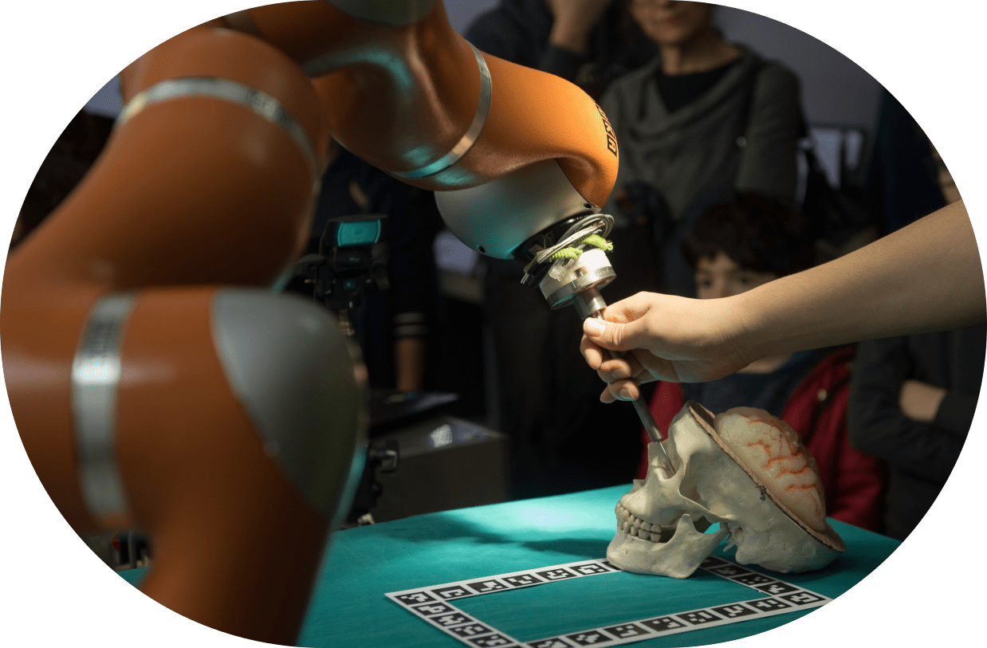
Lezione 3
Competition!
TEMA: ?
Lezione 4
ChatGPT
Privacy / AI Act / Explainability

Slide 5
Whistler o Derain?

Slide 6
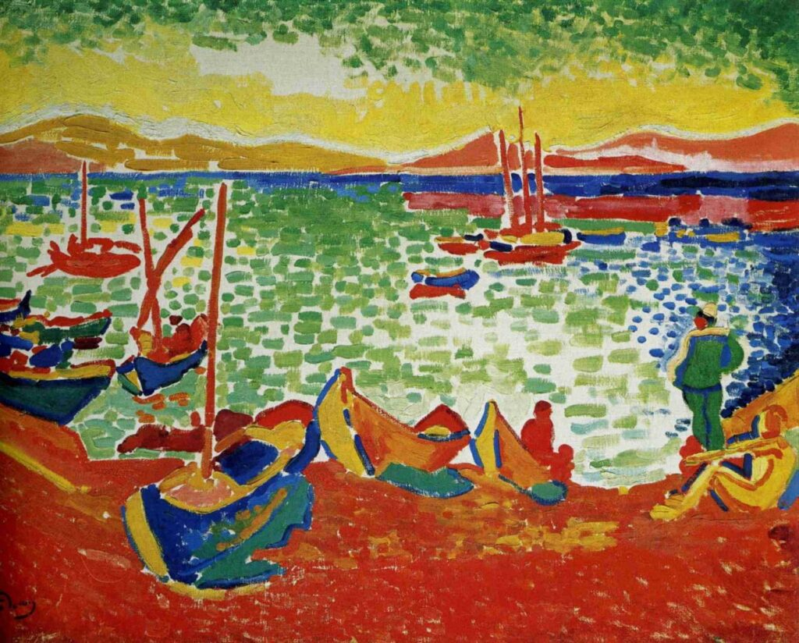
Derain

Slide 7
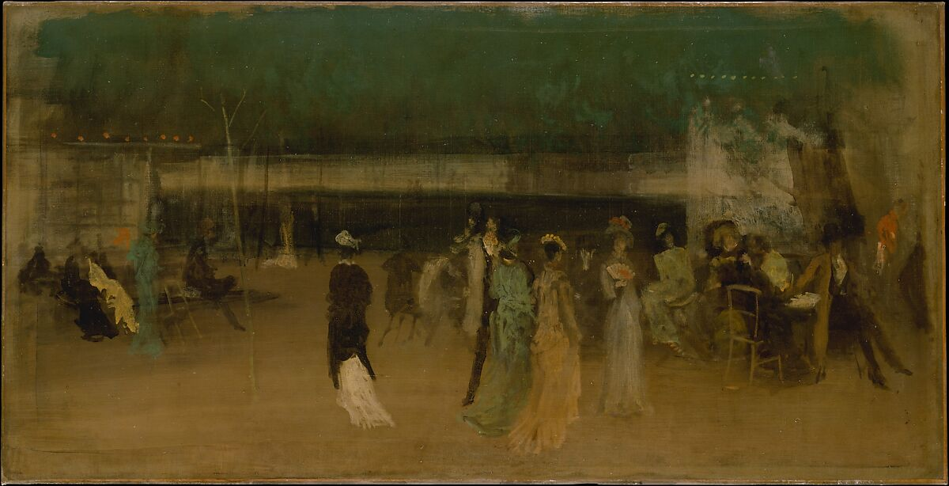
Whistler

Slide 8
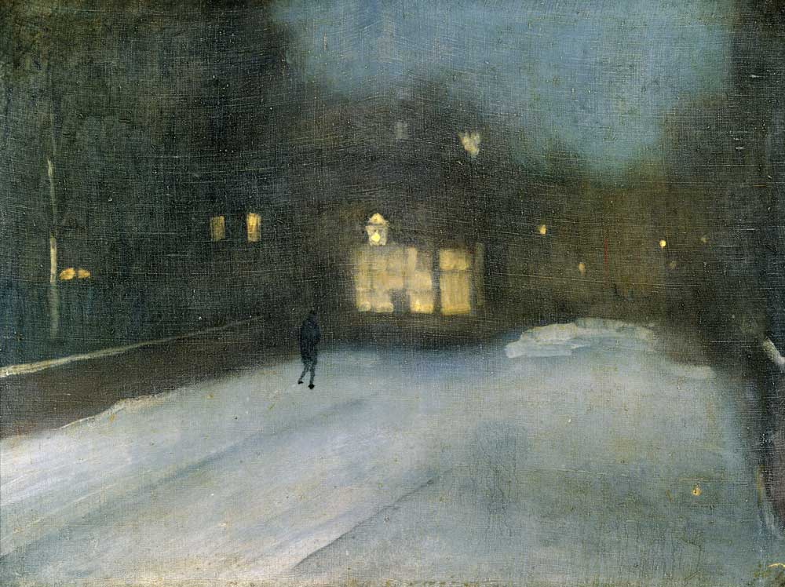
Whistler

Slide 9
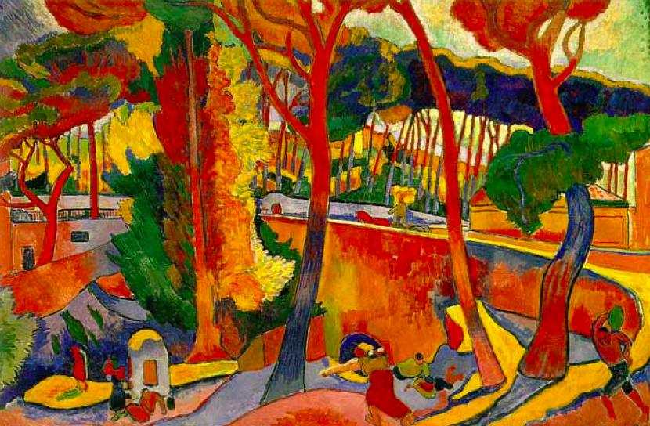
Derain

Slide 10
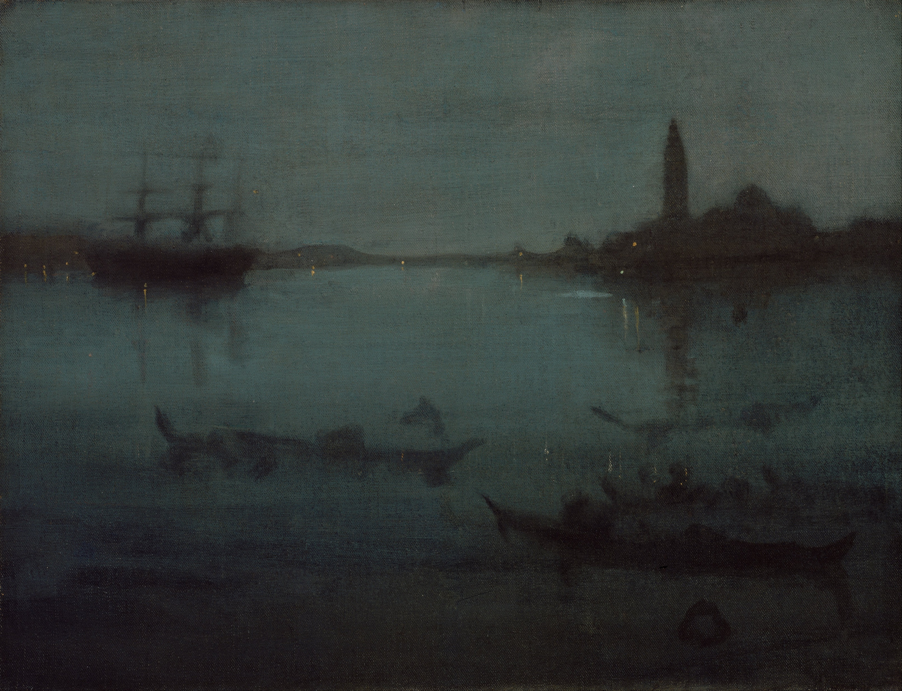
Whistler

Slide 11

Derain

Slide 12
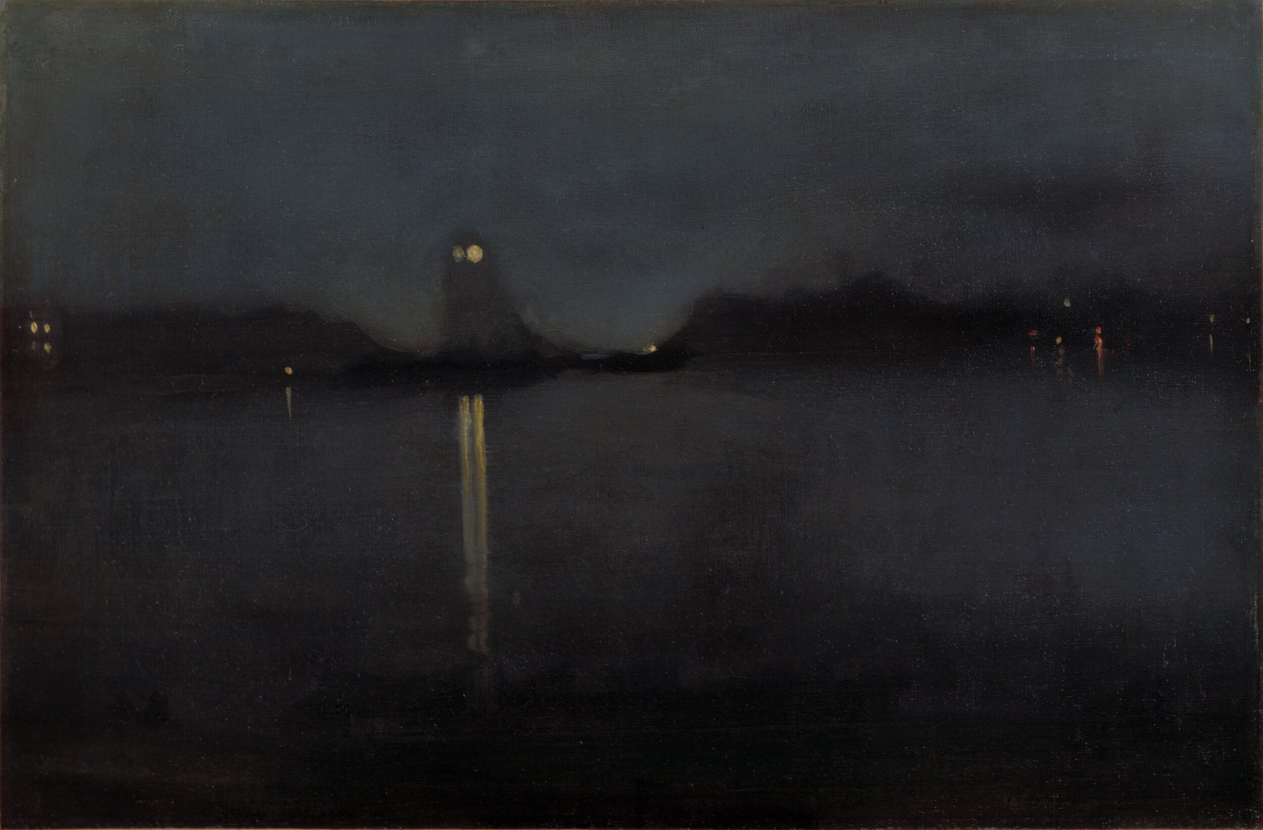
Whistler

Slide 13

Derain

Slide 14
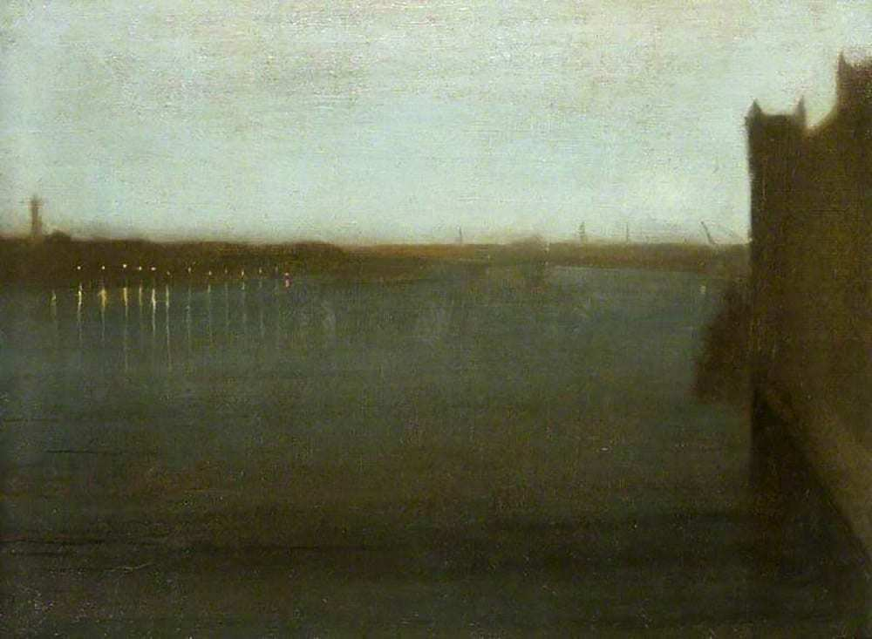
Whistler

Slide 15
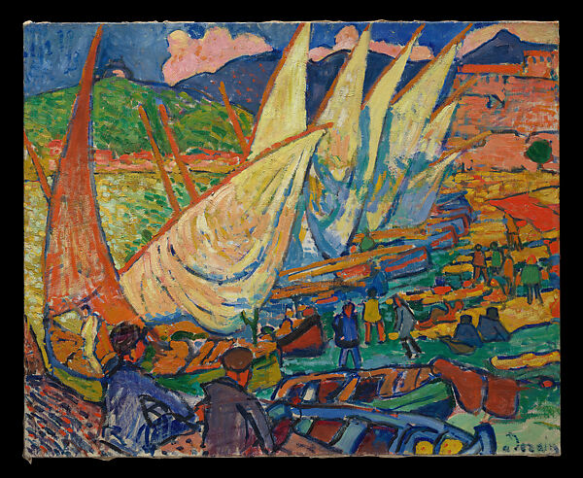
Derain

Slide 16

Derain

Slide 17

Whistler

Slide 18

Derain

Slide 19
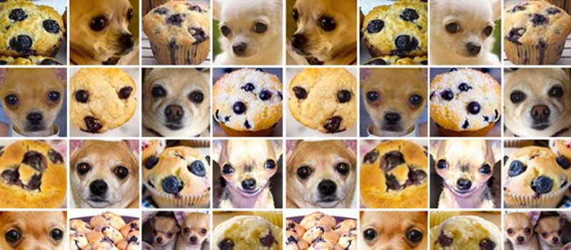

Slide 20
Neurons and Plasticity

Slide 21
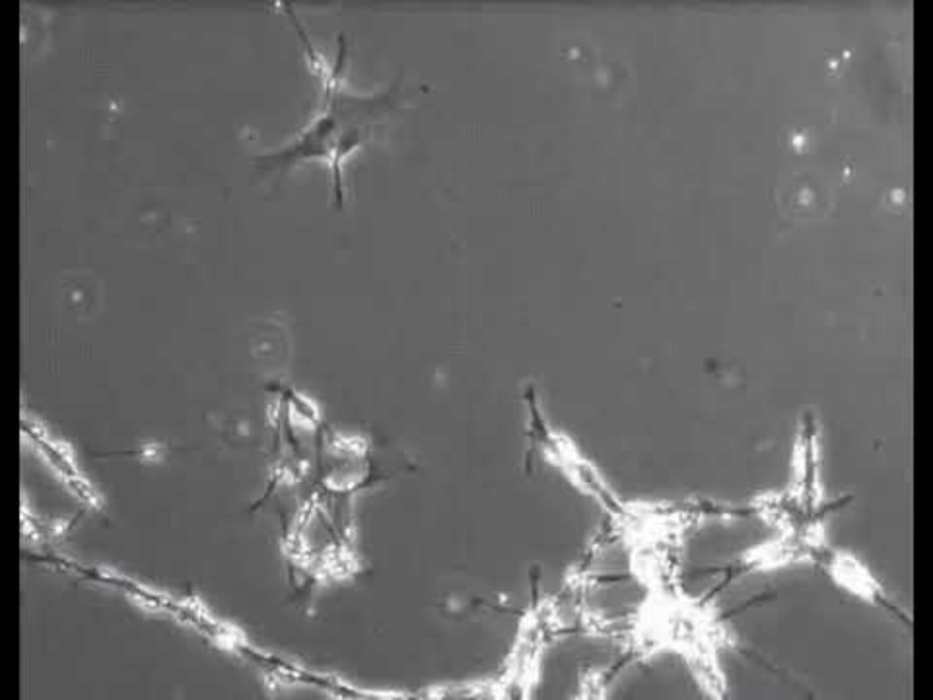

Slide 22
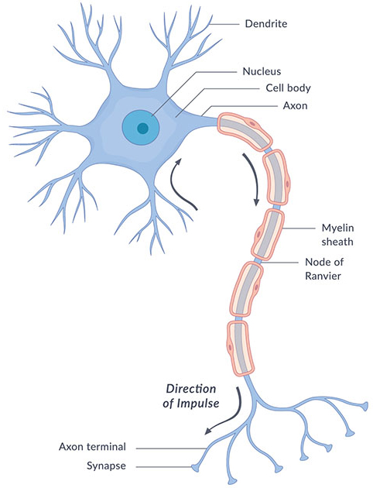
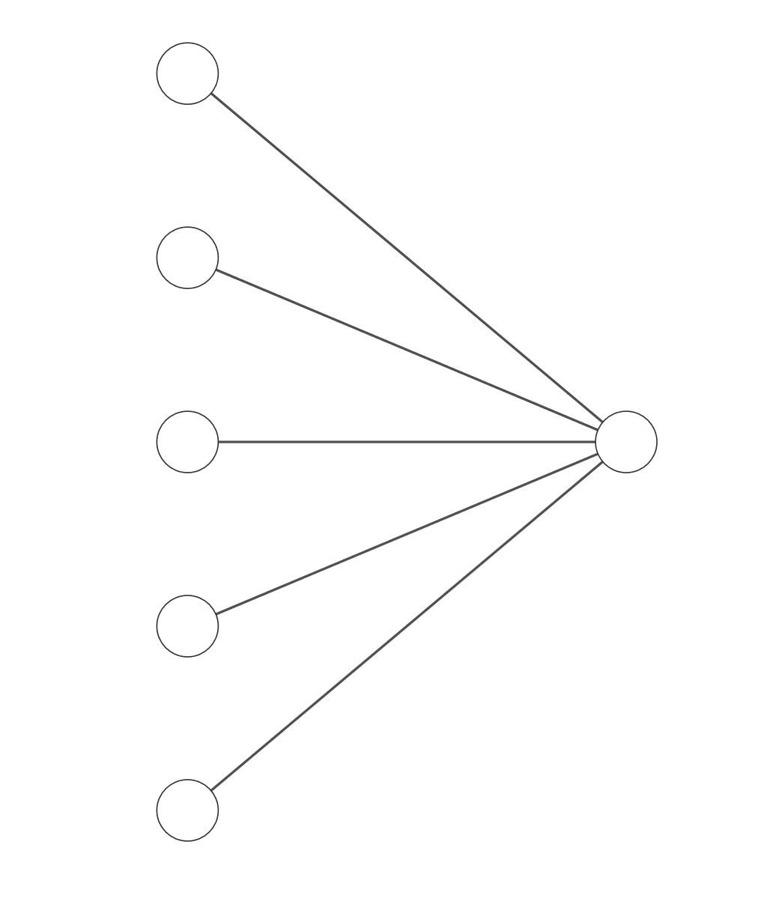
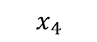
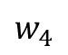
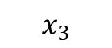
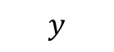
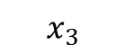
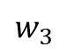
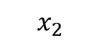
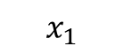
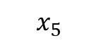
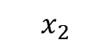
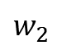
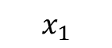
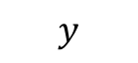
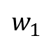
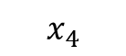
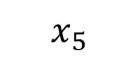
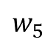
$$x_{2}$$
$$x_{1}$$
$$x_{1}$$
$$x_{3}$$
$$x_{2}$$
$$w_{1}$$
$$w_{2}$$
$$x_{4}$$
$$x_{3}$$
$$w_{3}$$
$$y$$
$$x_{5}$$
$$w_{4}$$
$$x_{4}$$
$$w_{5}$$
$$y$$
$$x_{5}$$

Slide 23
$$x_{2}$$
$$x_{1}$$
$$x_{1}$$
$$x_{3}$$
$$x_{2}$$
$$w_{1}$$
$$w_{2}$$
$$x_{4}$$
$$x_{3}$$
$$w_{3}$$
$$y$$
$$x_{5}$$
$$w_{4}$$
$$x_{4}$$
$$w_{5}$$
$$y$$
$$x_{5}$$

Slide 24
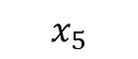
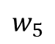
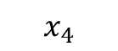
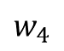
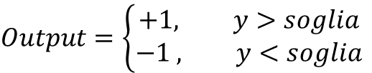
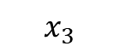
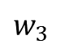
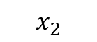
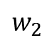
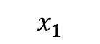
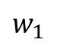
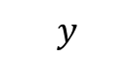
$$x_{1}$$
$$x_{2}$$
$$w_{1}$$
soglia
$$w_{2}$$
Neuron
$$x_{3}$$
$$w_{3}$$
$$y$$
$$y=x_{1}⋅w_{1}+x_{2}⋅w_{2}+x_{3}⋅w_{3}+x_{4}⋅w_{4}+x_{5}⋅w_{5}+…$$
$$w_{4}$$
$$Output=\left\{\begin{aligned}+1, y>soglia \\ −1 , y<soglia\end{aligned}\right.$$
$$x_{4}$$
$$w_{5}$$
$$x_{5}$$

Slide 25
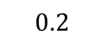
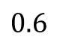
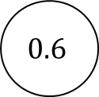

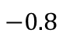
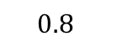
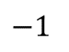

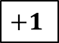
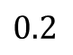


$$x_{2}$$
$$x_{1}$$
$$1$$
$$x_{3}$$
0.3
$$0.8$$
$$0.2$$
$$−1$$
$$x_{4}$$
$$0.6$$
$$0$$
$$−0.8$$
$$+1$$
$$x_{5}$$
$$0.6$$
$$0.2$$
$$−0.1$$
$$y$$
$$1.2$$
$$y=x_{1}⋅w_{1}+x_{2}⋅w_{2}+x_{3}⋅w_{3}+x_{4}⋅w_{4}+x_{5}⋅w_{5}$$

Slide 26






$$x_{2}$$
$$x_{1}$$
$$0.8$$
$$x_{3}$$
0.3
$$0.4$$
$$0.2$$
$$−1$$
$$x_{4}$$
$$+0.52$$
$$0.1$$
$$−0.8$$
$$-1$$
$$x_{5}$$
$$0.6$$
1.5
$$−0.1$$
$$y$$
$$0.6$$
$$y=x_{1}⋅w_{1}+x_{2}⋅w_{2}+x_{3}⋅w_{3}+x_{4}⋅w_{4}+x_{5}⋅w_{5}$$

Slide 27
Neural Training and Learning

Slide 28


$$x_{1}$$
$$w_{1}$$
Neuron
$$x_{2}$$
soglia
$$w_{2}$$
$$y=x_{1}⋅w_{1}+x_{2}⋅w_{2}+x_{3}⋅w_{3}+x_{4}⋅w_{4}+x_{5}⋅w_{5}+…$$
$$Output=\left\{\begin{aligned}+1, y>soglia \\ −1 , y<soglia\end{aligned}\right.$$
$$x_{3}$$
$$w_{3}$$
$$y$$
$$w_{4}$$
Learning
$$x_{4}$$
$$w_{5}$$
$$w_{1,new}=w_{1,old}+α⋅Errore⋅x_{1}$$
$Errore =Target −Output$
$α=Learning Rate$
$$x_{5}$$

Slide 29















$$1$$
$Errore =−1 −\left(+1\right)=−2$
$α=0.01$
$$0.2$$
0.3
$$w_{1,new}=w_{1,old}+α⋅Errore⋅x_{1}$$
$=0.2+0.01⋅\left(−2\right)⋅1=0.18$
$$0.8$$
$$−1$$
$$−0.8$$
$$0.6$$
$$0$$
$$+1$$
$$−1$$
$$0.6$$
$$0.2$$
$$−0.1$$
$$1.2$$

Slide 30




$$1$$
$Errore =−1 −\left(+1\right)=−2$
$α=0.01$
$0.18$
0.3
$$w_{1,new}=w_{1,old}+α⋅Errore⋅x_{1}$$
$=0.2+0.01⋅\left(−2\right)⋅1=0.18$
$$0.8$$
$$−1$$
$$w_{2,new}=w_{2,old}+α⋅Errore⋅x_{2}$$
$=−1+0.01⋅\left(−2\right)⋅0.8=−1.016$
$$−0.8$$
$$0.6$$
$$0$$
$$+1$$
$$−1$$
$$0.6$$
$$0.2$$
$$−0.1$$
$$1.2$$

Slide 31




$$1$$
$Errore =−1 −\left(+1\right)=−2$
$α=0.01$
$0.18$
0.3
$$w_{1,new}=w_{1,old}+α⋅Errore⋅x_{1}$$
$=0.2+0.01⋅\left(−2\right)⋅1=0.18$
$$0.8$$
$$−1.016$$
$$w_{2,new}=w_{2,old}+α⋅Errore⋅x_{2}$$
$=−1+0.01⋅\left(−2\right)⋅0.8=−1.016$
$$−0.8$$
$$0.6$$
$$0$$
$$+1$$
$$−1$$
$$w_{3,new}=w_{3,old}+α⋅Errore⋅x_{3}$$
$=−0.8+0.01⋅\left(−2\right)⋅0=−0.8$
$$0.6$$
$$0.2$$
$$−0.1$$
$$1.2$$

Slide 32




$$1$$
$Errore =−1 −\left(+1\right)=−2$
$α=0.01$
$0.18$
0.3
$$w_{1,new}=w_{1,old}+α⋅Errore⋅x_{1}$$
$=0.2+0.01⋅\left(−2\right)⋅1=0.18$
$$0.8$$
$$−1.016$$
$$w_{2,new}=w_{2,old}+α⋅Errore⋅x_{2}$$
$=−1+0.01⋅\left(−2\right)⋅0.8=−1.016$
$$−0.8$$
$$0.6$$
$$0$$
$$+1$$
$$−1$$
$$w_{3,new}=w_{3,old}+α⋅Errore⋅x_{3}$$
$=−0.8+0.01⋅\left(−2\right)⋅0=−0.8$
$$0.6$$
$$0.2$$
$$−0.1$$
$$w_{4,new}=w_{4,old}+α⋅Errore⋅x_{4}$$
$=0.6+0.01⋅\left(−2\right)⋅0.2=0.596$
$$1.2$$

Slide 33



$$1$$
$Errore =−1 −\left(+1\right)=−2$
$α=0.01$
$0.18$
0.3
$$w_{1,new}=w_{1,old}+α⋅Errore⋅x_{1}$$
$=0.2+0.01⋅\left(−2\right)⋅1=0.18$
$$0.8$$
$$−1.016$$
$$w_{2,new}=w_{2,old}+α⋅Errore⋅x_{2}$$
$=−1+0.01⋅\left(−2\right)⋅0.8=−1.016$
$$−0.8$$
$$0.6$$
$$0$$
$$+1$$
$$−1$$
$$w_{3,new}=w_{3,old}+α⋅Errore⋅x_{3}$$
$=−0.8+0.01⋅\left(−2\right)⋅0=−0.8$
$$0.596$$
$$0.2$$
$$−0.1$$
$$w_{4,new}=w_{4,old}+α⋅Errore⋅x_{4}$$
$=0.6+0.01⋅\left(−2\right)⋅0.2=0.596$
$$w_{5,new}=w_{5,old}+α⋅Errore⋅x_{5}$$
$=−0.1+0.01⋅\left(−2\right)⋅1.2=−0.124$
$$1.2$$

Slide 34


























$$1$$
$$1$$
$$0.2$$
0.3
$0.18$
0.3
$$0.8$$
$$0.8$$
$$−1$$
$$−1.016$$
$$−0.8$$
$$0.6$$
$$−0.8$$
$$0.6$$
$$0$$
$$+1$$
$$0$$
$$+1$$
$$−1$$
$$−1$$
$$0.6$$
$$0.596$$
$$0.2$$
$$−0.1$$
$$0.2$$
$$−0.124$$
$$1.2$$
$$1.2$$

Slide 35
Increasing Complexity

Slide 36




Slide 37


Slide 38


Slide 39


Slide 40
Data Quality

Slide 41

Derain
Matisse

Slide 42
Derain
Whistler

Slide 43

Whistler
Corrupt

Slide 44

Derain
Leonardo

